Slide 1
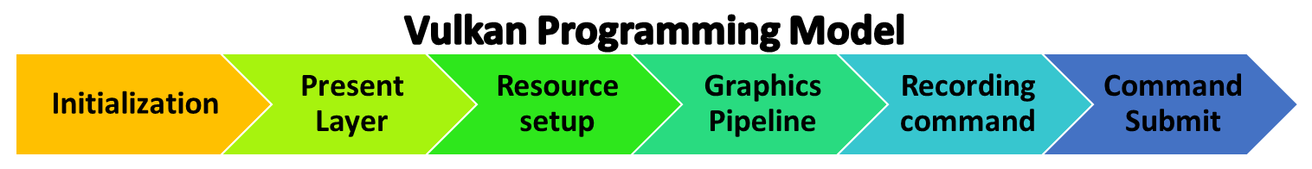
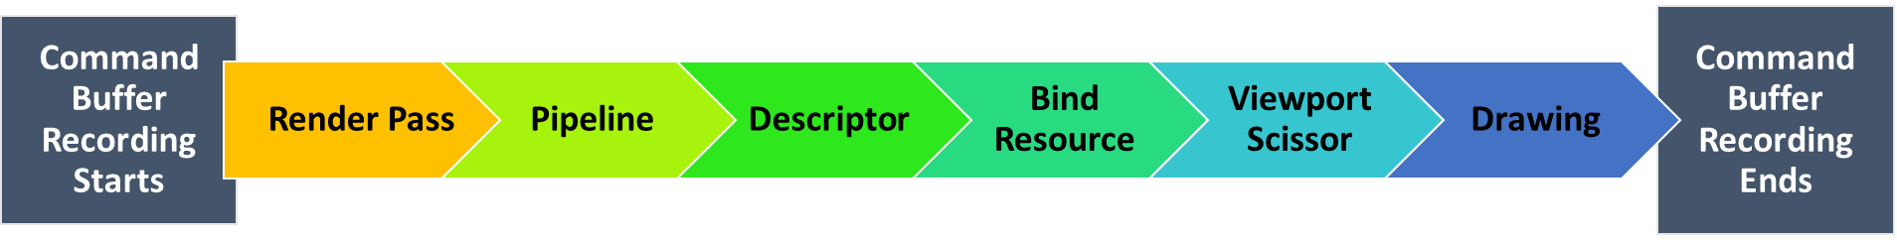
Vulkan Programming Model
Initialization
Resource setup
Graphics Pipeline
Recording command
Present Layer
Command Submit
Command Buffer Recording Starts
Command Buffer Recording Ends
Render Pass
Pipeline
Descriptor
Bind Resource
Viewport Scissor
Drawing

Slide 2
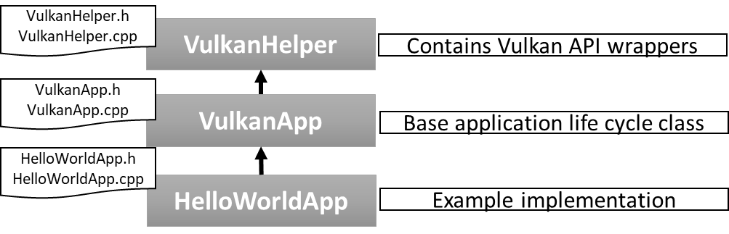
VulkanHelper.h
VulkanHelper.cpp
VulkanHelper
Contains Vulkan API wrappers
VulkanApp.h
VulkanApp.cpp
VulkanApp
Base application life cycle class
HelloWorldApp.h
HelloWorldApp.cpp
HelloWorldApp
Example implementation

Slide 3
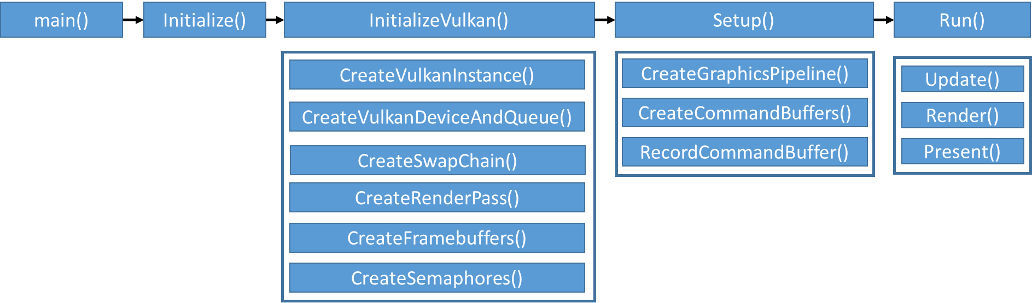
main()
Initialize()
InitializeVulkan()
Setup()
Run()
CreateVulkanInstance()
CreateGraphicsPipeline()
Update()
CreateVulkanDeviceAndQueue()
CreateCommandBuffers()
Render()
CreateSwapChain()
RecordCommandBuffer()
Present()
CreateRenderPass()
CreateFramebuffers()
CreateSemaphores()

Slide 4
Z+
Y+
Z+
X+
X+
Y+
Vulkan Coordinate System
Right Hand NDC space
OpenGL Coordinate System
Left Hand NDC space

Slide 5
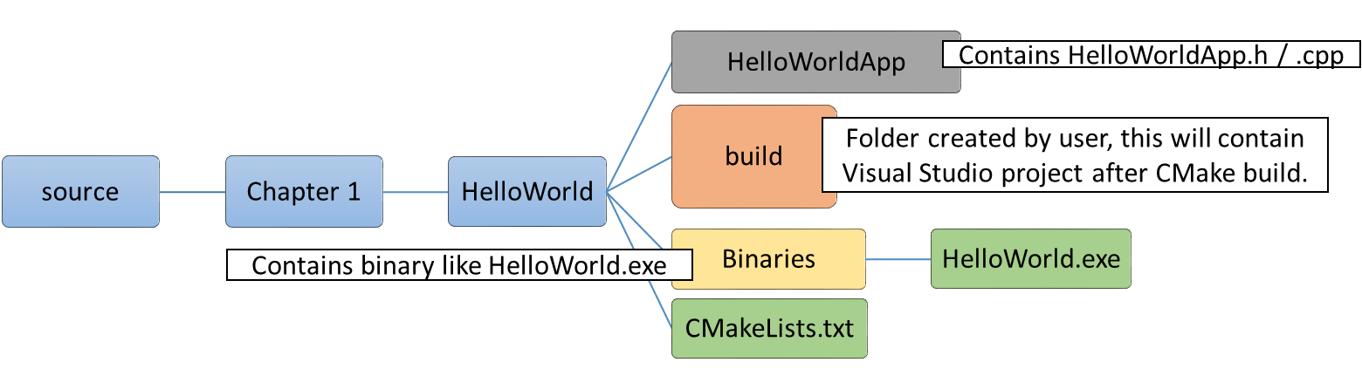
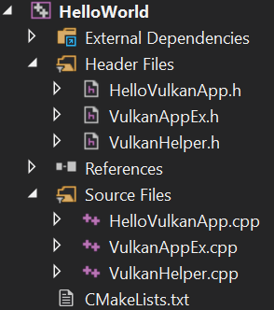
source
Chapter 1
HelloWorld
HelloWorldApp
build
Binaries
HelloWorld.exe
CMakeLists.txt
Contains HelloWorldApp.h / .cpp
Folder created by user, this will contain Visual Studio project after CMake build.
Contains binary like HelloWorld.exe
source
Common
Chapter 1
Chapter 2
VulkanHelper
VulkanApp
HelloWorld
HelloWorldApp
. . .

Slide 6
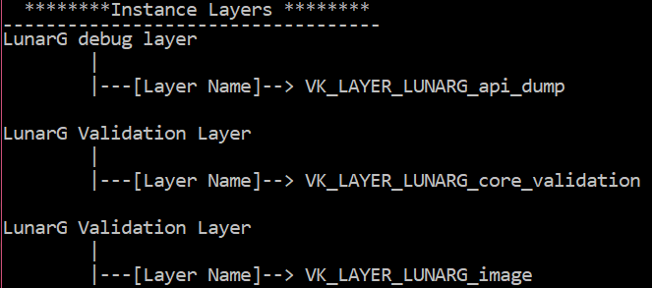
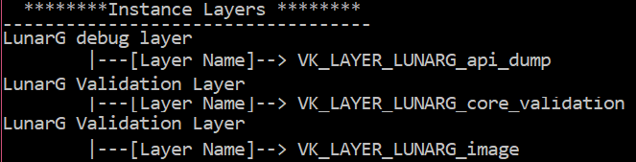

Slide 7
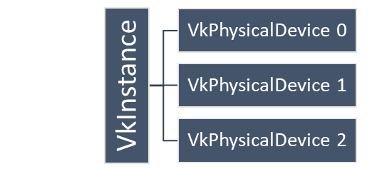
VkInstance
VkPhysicalDevice 0
VkPhysicalDevice 1
VkPhysicalDevice 2
Queue Type
Graphics Queue
Compute Queue
Transfer Queue
Sparse Queue
Application
Instances
Instances
Physical Devices
Physical Devices
Physical Devices
Logical Device
Logical Device
Logical Devices
Logical Devices
Queue
Queue
Queue
Queue
Queue
Queue

Slide 8
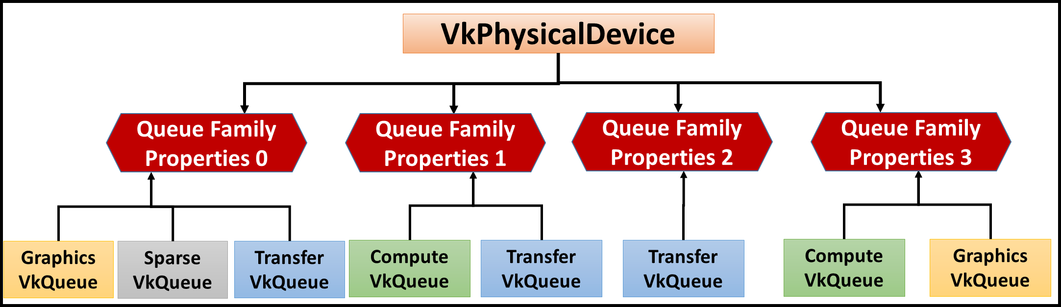
VkPhysicalDevice
Queue Family
Properties 0
Queue Family
Properties 1
Queue Family
Properties 2
Queue Family
Properties 3
Graphics
VkQueue
Sparse
VkQueue
Transfer
VkQueue
Compute
VkQueue
Transfer
VkQueue
Transfer
VkQueue
Compute
VkQueue
Graphics
VkQueue

Slide 9
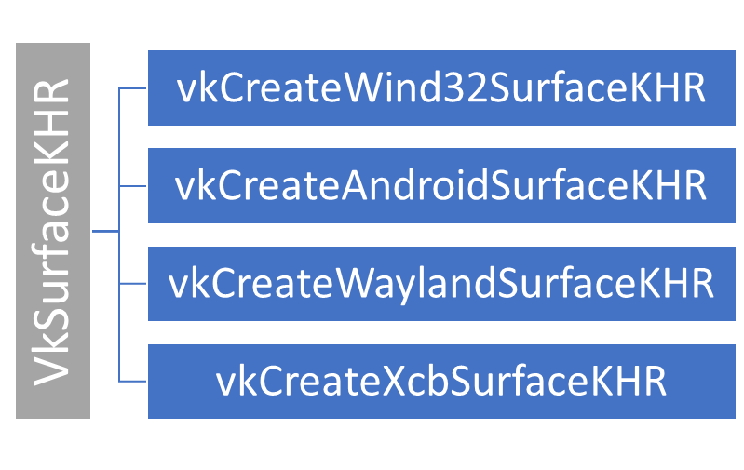
VkSurfaceKHR
vkCreateWind32SurfaceKHR
vkCreateAndroidSurfaceKHR
vkCreateWaylandSurfaceKHR
vkCreateXcbSurfaceKHR

